Slide 1
List Corpus

Slide 2
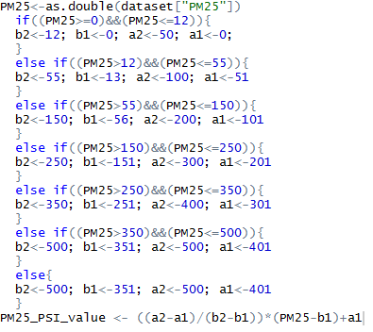
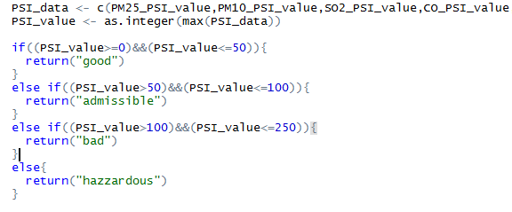
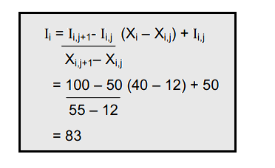
Data Interpretation – AirQuality_interpreter()
System Category | PSI Index | PSI | PM25 | PM10 | SO₂ | CO | O₃ | NO₂
Good | Good | 0-50 | 0-12 | 0-50 | 0-80 | 0-5 | 0-118 | 0
Admissible | Moderate | 51-100 | 13-55 | 51-15 | 81-365 | 5.1-10 | 119-157 | 0
Bad | Unhealthy | 101-200 | 56-150 | 151-350 | 366-800 | 10.1-17.0 | 158-235 | 1130
 | Very Unhealthy | 201-300 | 151-250 | 351-420 | 801-1600 | 17.1-34.0 | 236-785 | 1131-2260
Hazzardous | Hazzardous | 301-400 | 251-350 | 421-500 | 1601-2100 | 34.1-46.0 | 786-980 | 2261-3000
 |  | 401-500 | 351-500 | 501-600 | 2101-2620 | 46.1-57.5 | 981-1180 | 3001-3750

Slide 3
Data Interpretation – Wind speed
No | Speed (km/h) | Kelas
1 | x < 2 | Calm
2 | 2 <= x < 5 | Light Air
3 | 6 <= x < 11 | Light Breeze
4 | 12 <= x < 19 | Gentle Breeze
5 | 20 <= x < 29 | Moderate Breeze
6 | 30 <= x < 39 | Fresh Breeze
7 | 40 <= x < 50 | Strong Breeze
8 | 51 <= x < 61 | Near Gale
9 | 62 <= x < 74 | Gale
10 | 74 <= x < 87 | Strong Gale
11 | 88 <= x < 102 | Storm
12 | 103 <= x < 118 | Violent Storm
13 | 119 <= x < 130 | Hurricane

Slide 4
Data Interpretation – Wind Direction
No | degree | class
1 | 348.75-11.25 | North
2 | 11.25-33.75 | North North East
3 | 33.75-56.25 | North East
4 | 56.25-78.75 | East North East
5 | 78.75-101.25 | East
6 | 101.25-123..75 | East South East
7 | 123.75-146.25 | South East
8 | 146.25-168.75 | South South East
9 | 168.75-191.25 | South
10 | 191.25-213.75 | South South West
11 | 213.75-236.25 | South West
12 | 236.25-258.75 | West South West
13 | 258.75-281.25 | West
14 | 281.25-303.75 | West North West
15 | 303.75-326.25 | North West
16 | 326.25-348.75 | North North West

Slide 5
Data Interpretation – Cloud Coverage
NO | Cakupan Awan (%) | kelas
1 | 0-10 | Clear
2 | 10-20 | Foggy
3 | 20-30 | Mostly sunny
4 | 40-60 | Partly cloudy
5 | 70-80 | Mostly cloudy
6 | 80-90 | Broken
7 | 90-100 | overcast

Slide 6
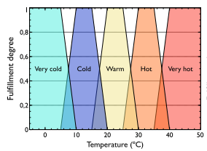
Data Interpretation – Temperature

Slide 7
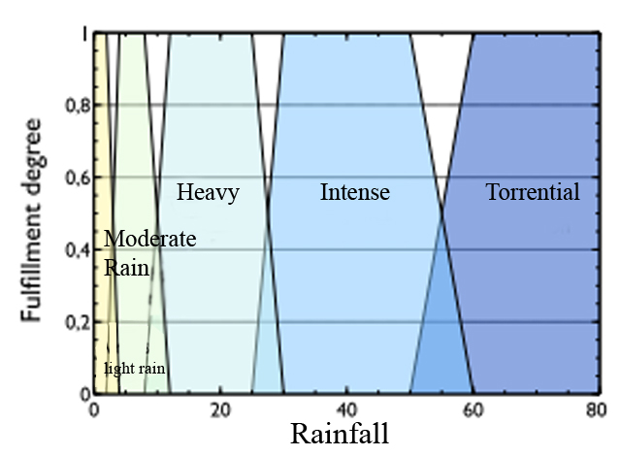
Data Interpretation – Rainfall

Slide 8
Doc Planning
Perdiction Result
Weather Summary
[1] “ Regarding to the prediction result, tomorrow sky state will be light rain although its covered by partly cloudy sky"
[2] “ Followed by temperature which increased to warm"
[3] “ According to the air quality state, it will still stable at good "
[1] “ According to the monthly summary result, this month was cooler and wetter than average"
[2] " With average number of rain days, the total rain so far is well above the average "
[3] " There was rain on everyday for 4 days from 27th to 30th and heavy rain were spilled in 28th and 29th“
[4] " The wind for the month was light breeze in average"
[5] " Average air quality was admissible"
[6] " Average temperature was increased but 29 th was the coldest day of the month with 14,5 celcius degree temperature"

Slide 9
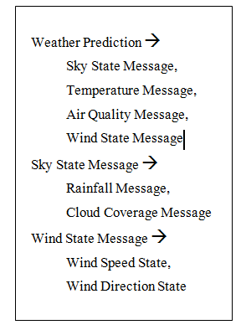
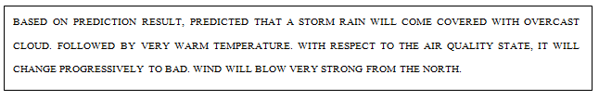
Doc Planning – Weather Prediction
Routine Message -> Rainfall, Cloud & Air Quality
Significant Event Message -> Wind Speed & Wind Direction

Slide 10
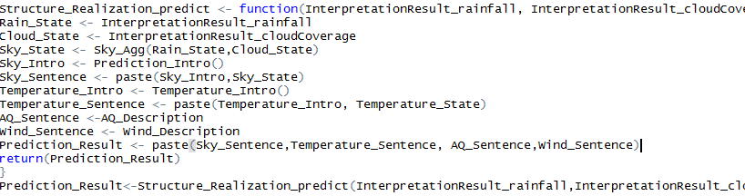
Microplanning - Weather Prediction
[1] "Tomorrow sky state is predicted that the sky will be light rain although its covered by partly cloudy sky"
[2] " Followed by temperature which increased to warm"
[3] " According to the air quality state, it will keep stable at good "
Sky Sentence
Temperature Sentence
AQ sentence
Wind Sentence

Slide 11

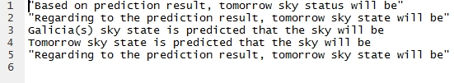
Weather Prediction(1) – Sky Sentence
[1] "Tomorrow sky state is predicted that the sky will be light rain although its covered by partly cloudy sky“
red = sky_intro
blue = sky_state
Sky_Intro:

Slide 12
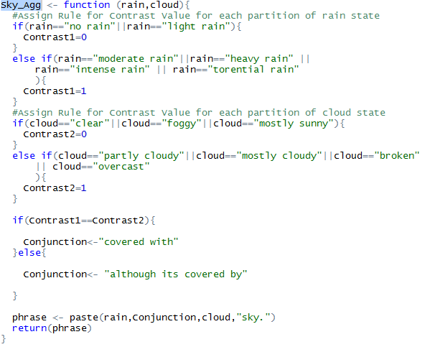
Sky Sentence – Sky_state (2)
Sky_State <- Sky_Agg(Rain_State,Cloud_State)
"light rain although its covered by partly cloudy sky.“
light rain = message1 (contrast 0)
partly cloudy = message2 (contrast 1)
although its covered by = conjunction

Slide 13

Weather Prediction(2) – Temperature Sentence
[2] " Followed by temperature which increased to warm"
Temperature_Sentence <- paste(Temperature_Intro, Temperature_State)
Temperature_Intro
Temperature_State<-paste(TrendDesc_Temperature, InterpretationResult_temperature)
increased to (TrendDesc_Temperature) warm (InterpretationResult_temperature)
TrendDesc_Temperature <- TrendDesc_2(as.double(TodaysWeather["Temperature"]), as.double(y[,"Average.Temperature"]))

Slide 14
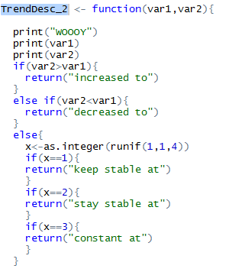
Temperature Sentence - TrendDesc_Temperature
Input: Value1, Value2
Output:

Slide 15

Weather Prediction(3) - AQ sentence
[3] " According to the air quality state, it will keep stable at good "
AQ_Description <- paste(Intro_AQ,TrendDesc_AQ,AQ_seq[3],".")
Intro_AQ
AQ_seq[3] <- InterpretationResult_airQuality *Prediksi AQ, output dr data interpertation*

Slide 16
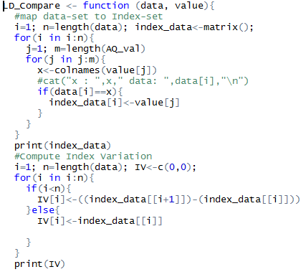
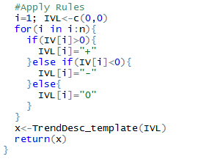
AQ sentence – TrendDesc_AQ (1)
TrendDesc_AQ <- LD_Compare(AQ_seq,AQ_val) (skripsi hal 81)

Slide 17
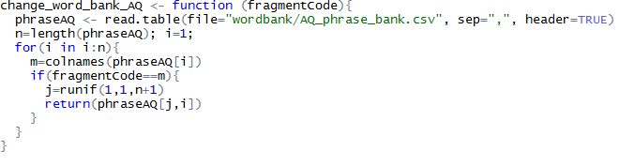
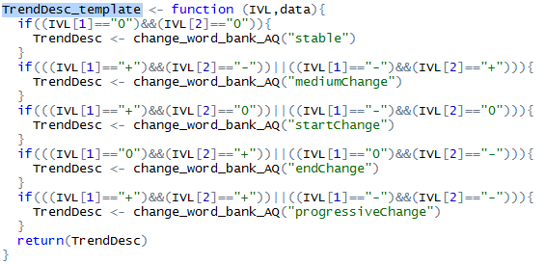
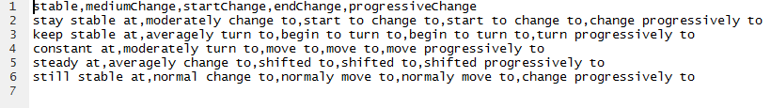
AQ sentence – TrendDesc_AQ (2)
TrendDesc_Template

Slide 18
Weather Prediction(4) - AQ sentence
strong breeze = wind speed
from the west = wind direction
[1] "the wind will blow strong breeze from the west."

Slide 19
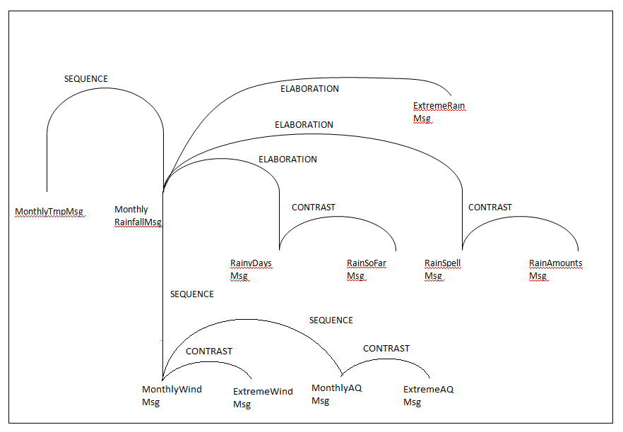
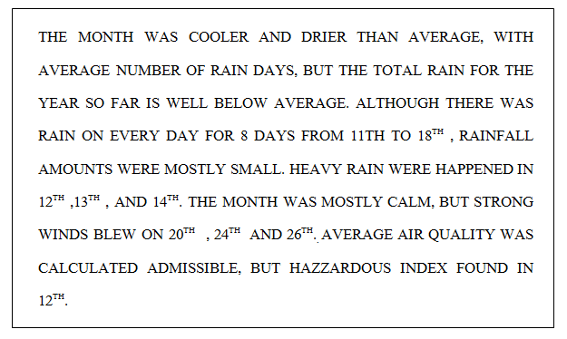
Doc Planning – Weather Summary
Target Corpus:

Slide 20
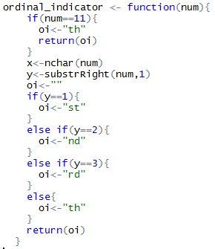
Weather Summary – Ordinal number
Input: Number
Output: Ordinal number
Ex: Param = 1, return 1st
Ex: Param = 2, return 2nd
etc

Slide 21
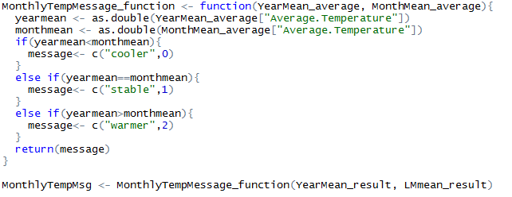
Weather Summary - MonthlyTempMsg
Input: Average temperature (Year), Average temperature (Last Month)
Output : cooler/stable/warmer

Slide 22
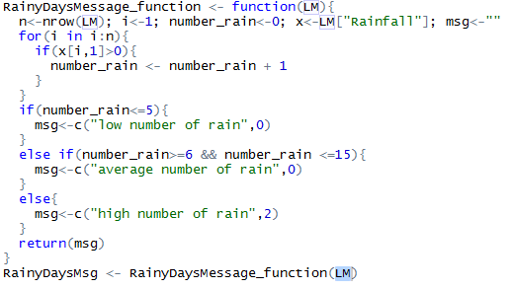
Weather Summary - RainyDayMsg
Input: Rainfall data (Last Month)
Output : Rainfall message

Slide 23
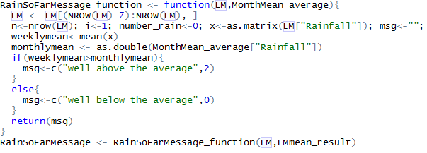
Weather Summary - RainSoFarMessage
Input: Rainfall data (Last Month), Rainfall average (Last Month)
Output : RainSoFarMessage
Ex: [1] "well above the average" "2"

Slide 24
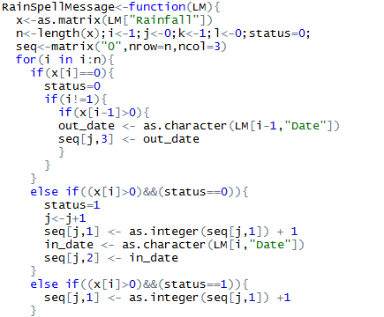
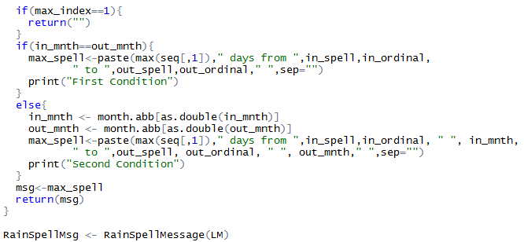
Weather Summary - RainSpellMsg
Input: Rainfall data (Last Month)
Output : RainSpellMessage
Ex: "6 days from 27th Jun to 2nd Jul "
[,1] [,2] [,3]
[1,] "2" "2017-06-08" "2017-06-09"
[2,] "1" "2017-06-13" "2017-06-13"
[3,] "1" "2017-06-22" "2017-06-22"
[4,] "6" "2017-06-27" "2017-07-02"

Slide 25
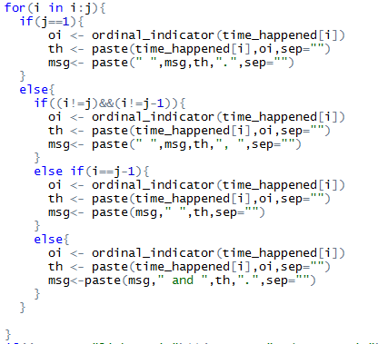
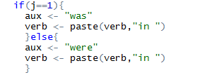
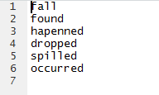
Weather Summary - RainExtremeMsg
Input: Rainfall data (Last Month)
Output : RainSpellMessage
Ex: "heavy rain were dropped in 28th and 29th“
Heavy rain = status
Were = auxiliary
Dropped = verb
28, 29 = date
Th = ordinal number

Slide 26
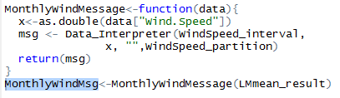
Weather Summary - MonthlyWindMsg
Input: Windspeed Mean (Last Month)
Output : MonthlyWindMsg (Almost same with Data interpretation)
Ex: "[1] "calm" "light air" "light breeze" "gentle breeze" "moderate breeze"
[6] "fresh breeze" "strong breeze" "near gale" "gale" "strong gale"
[11] "storm" "violent storm" "Hurrricane" "

Slide 27
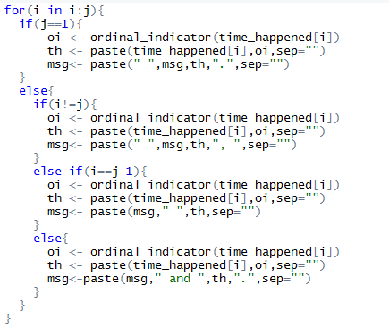
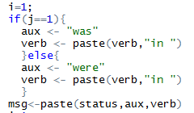
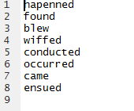
Weather Summary - WindExtremeMessage
Input: Windspeed Mean (Last Month)
Output : " Hurrricane was occurred in 5th, and 6th.“
Hurrricane = Status/Message
Was = aux
Occurred = verb
5, 6 = date
Th = ordinal

Slide 28
Microplanning - Weather Summary
Intro
MonthlyMsg1 <- MonthlyMsg1_aggregation(MonthlyTempMsg, MonthlyRainfallMsg)
MonthlyMsg2 <- MonthlyMsg2_aggregation(RainyDaysMsg, RainSoFarMessage)
MonthlyMsg3 <- MonthlyMsg3_aggregation(RainSpellMsg, RainExtremeMsg)
MonthlyMsg4 <- MonthlyMsg4_aggregation(MonthlyWindMsg, WindExtremeMsg)
MonthlyMsg5 <- MonthlyMsg5_aggregation(MonthlyAQMsg, "")
MonthlyMsg6 <- Coldest_day(LMmin_result, LMmean_result, MBLMmean_result)
[1] “ According to the monthly summary result, this month was cooler and wetter than average"
[2] " With average number of rain days, the total rain so far is well above the average "
[3] " There was rain on everyday for 4 days from 27th to 30th and heavy rain were spilled in 28th and 29th“
[4] " The wind for the month was light breeze in average"
[5] " Average air quality was admissible"
[6] " Average temperature was increased but 29 th was the coldest day of the month with 14,5 celcius degree temperature"

Slide 29
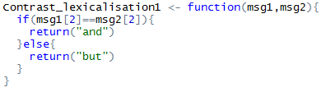
Weather Summary – Contrast Lex
Input: Data interpretation index (Ex: 0, 1, 2, etc)
Output: Conjunction (And, But)

Slide 30
Weather Summary– Intro
Random:
"Regarding to the monthly summary result, this month"
"According to the monthly summary result, this month"
"Summary result showed that this month”
“Condition of this month”
“This month summary showed that the month”

Slide 31
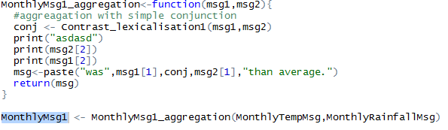
Weather Summary - MonthlyMsg1
Output:
Cooler, 0 = Message1
And = Conjunction
Wetter, 0 = Message 2
"was cooler and wetter than average."

Slide 32
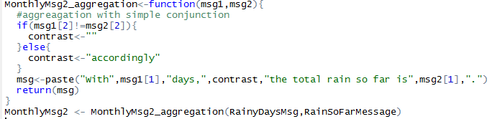
Weather Summary – MonthlyMsg2
Output:
average number of rain, 0 = message 1
“” = contrast
well above the average, 2 = message 2
"With average number of rain days, “” the total rain so far is well above the average ."

Slide 33
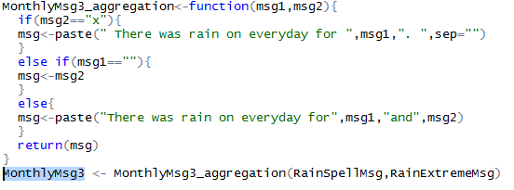
Weather Summary – MonthlyMsg3
Output:
4 days from 27th to 30th = message 1
heavy rain were spilled in 28th and 29th = message 2
"There was rain on everyday for 4 days from 27th to 30th and heavy rain were spilled in 28th and 29th."

Slide 34
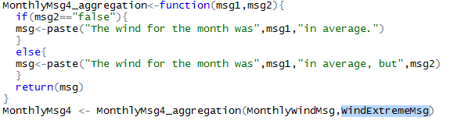
Weather Summary – MonthlyMsg4
Output:
light breeze = message 1
violent storm were ensued in 5th, and 6th = message 2
"The wind for the month was light breeze in average, but violent storm were ensued in 5th, and 6th."

Slide 35
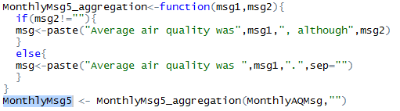
Weather Summary – MonthlyMsg5
Output:
admissible = message 1
"Average air quality was admissible."

Slide 36
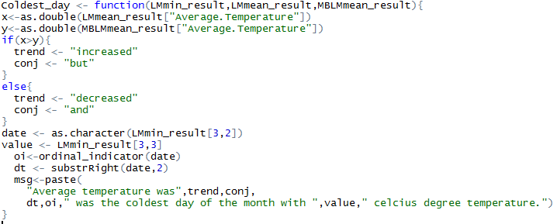
Weather Summary– Coldest Day
Input: LM Min Value, LM Mean Value, 2 LM mean Value
Output:
Increased = trend
But = Conj
29 = Date
Th = Ordinal
14.5 = Value
"Average temperature was increased but 29 th was the coldest day of the month with 14.5 celcius degree temperature."

